Slide 1
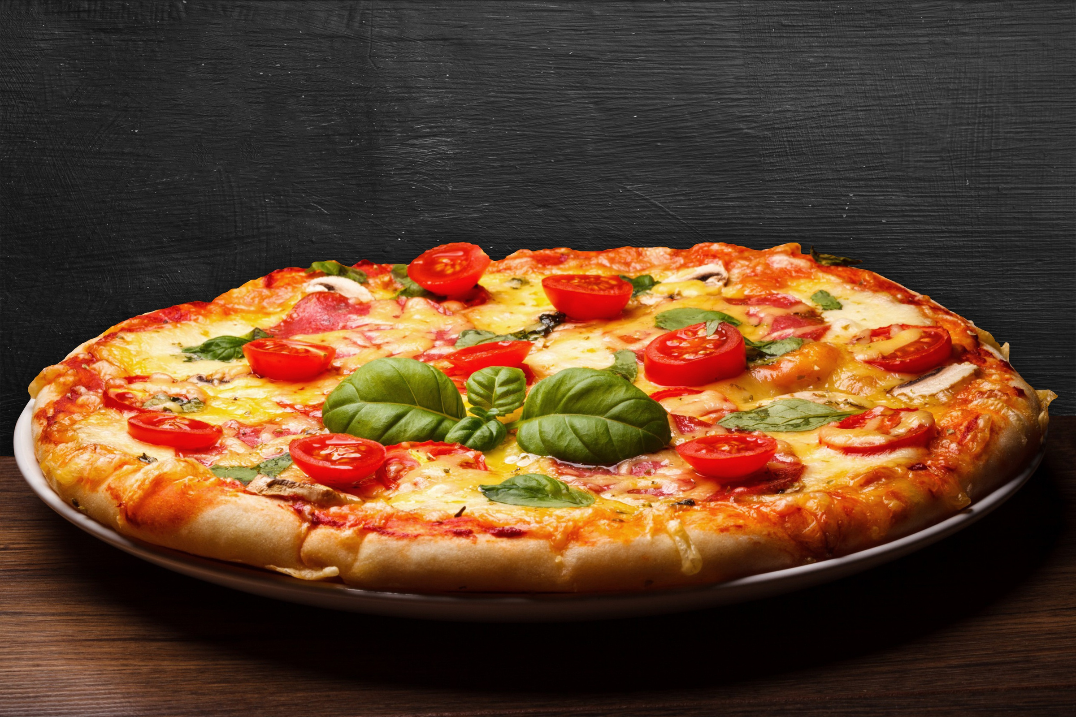
pizza sales analysis using sql

Slide 2



Total REvenue

Slide 3
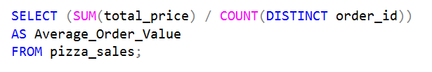
Avg order value

Slide 4

Total pizzas sold

Slide 5
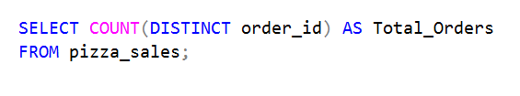
Total orders

Slide 6
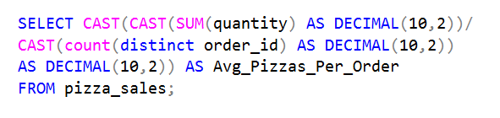
AVG PIZZA PER ORDER

Slide 7
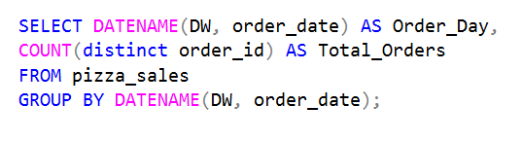
DAILY TRENDS FOR TOTAL ORDERS

Slide 8
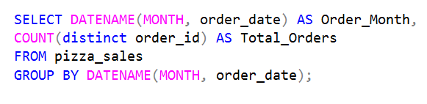
MONTHLY TRENDS FOR TOTAL ORDERS

Slide 9
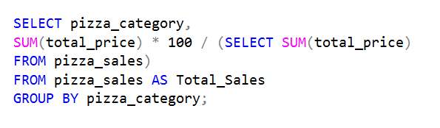
PERCENTAGE OF SALES BY PIZZA CATEGORY

Slide 10
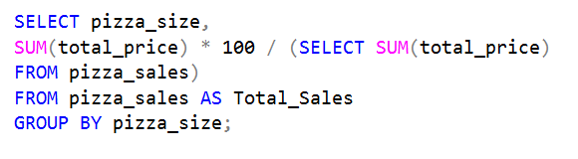
PERCENTAGE OF SALES BY PIZZA SIZE

Slide 11
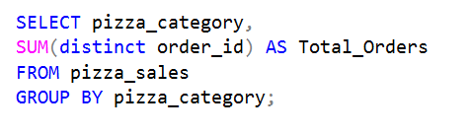
TOTAL PIZZAS SOLD BY CATEGORY

Slide 12
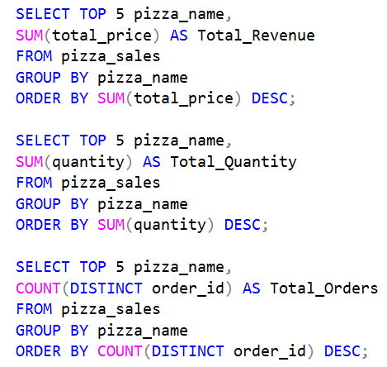
Top 5 bestseller Pizzas by Revenue, Total Quantity and Total Orders

Slide 13
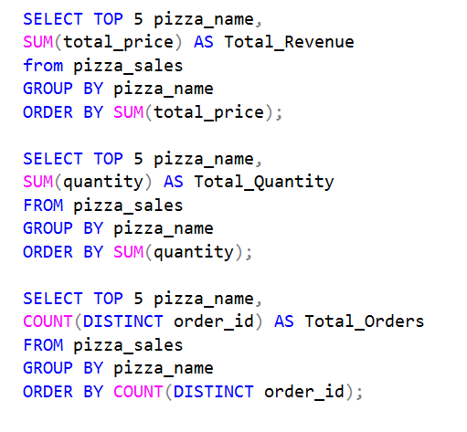
BOTTOM 5 bestseller Pizzas by Revenue, Total Quantity and Total Orders

Slide 14
thank you!

